Slide 1

50.039 Theory and Practice of Deep Learning W11-S3 More on Reinforcement Learning
Matthieu De Mari

Slide 2
About this week
What is Reinforcement Learning?
What are the key ideas behind reinforcement learning and its framework?
What is the exploration vs. exploitation tradeoff?
How do we train an RL agent by exploring, then progressively exploiting?
What are some advanced strategies in multi-arm bandit problems?
What are the Q and V functions for a RL problem?
What is Q-learning and how can it be implemented in RL problems?

Slide 3
About this week
What is Deep Q Learning? And which problem does it address?
What is RL with Human Feedback?
How to implement RLHF via the REINFORCE algorithm?
What are actor-critic learning methods? And which problems do these approaches address?
What are more advanced problems in RL?
Markov states
Partially observable environment
SARSA
Non-stationary problems

Slide 4
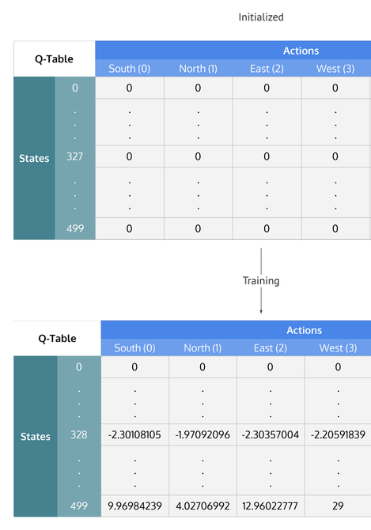
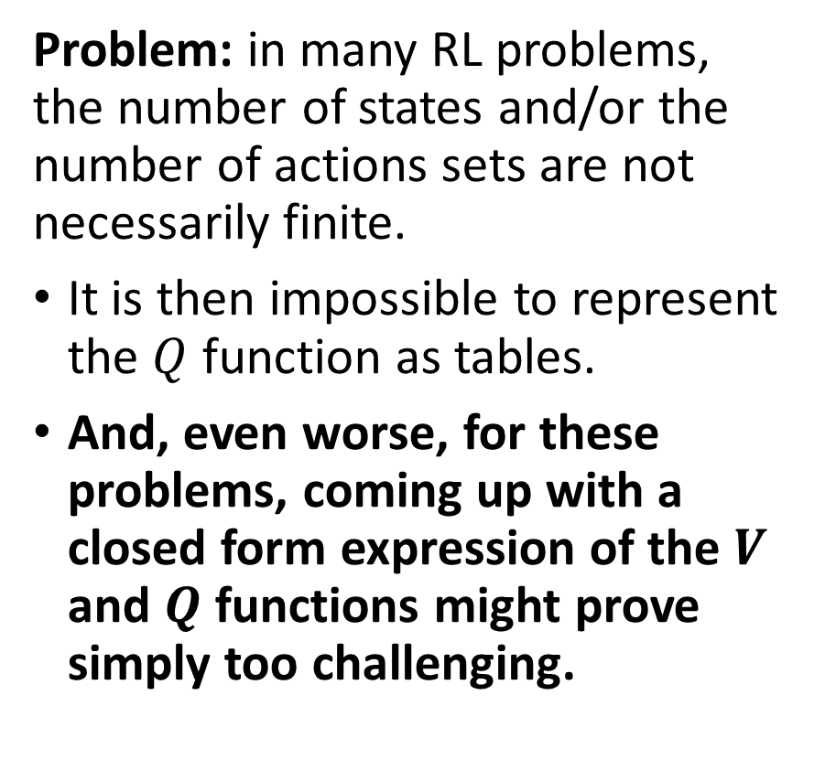
A representation problem
Problem: in many RL problems, the number of states and/or the number of actions sets are not necessarily finite.
It is then impossible to represent the $Q$ function as tables.
And, even worse, for these problems, coming up with a closed form expression of the $V$ and $Q$ functions might prove simply too challenging.

Slide 5
Limitations of Q-learning (last lecture)
Open question: What if the number of states and/or the number of actions is not finite?
We would not be able to use a Q-table to store values…
→ Idea: Replace the table with a Deep Learning model that predicts the value of Q for the given state and each possible action!
Train that model to match the theoretical Q-value!
Reuse all ideas from before regarding the updating of Q-values, exploration vs. exploitation, etc.

Slide 6
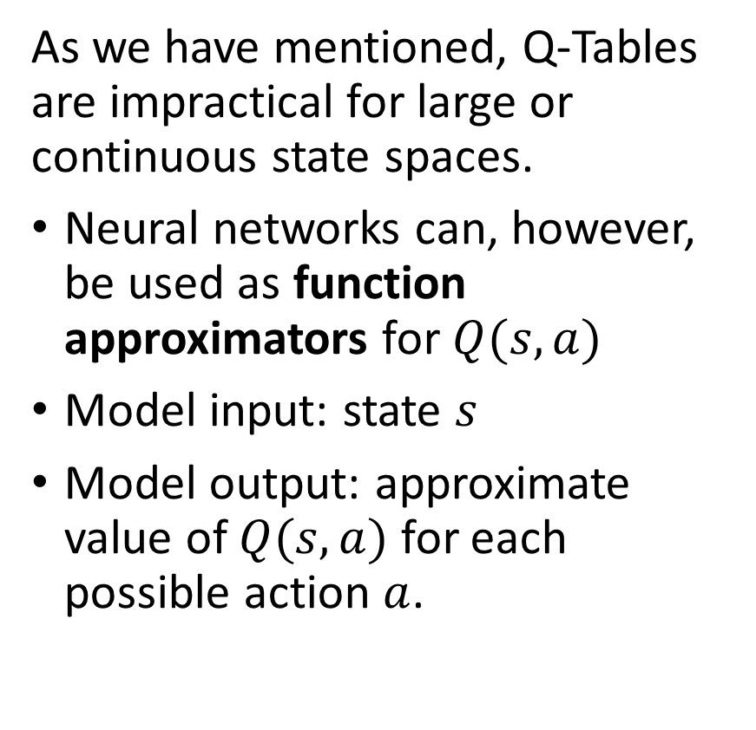
Using a NN model as a Q-function
As we have mentioned, Q-Tables are impractical for large or continuous state spaces.
Neural networks can, however, be used as function approximators for $Q(s, a)$
Model input: state $s$
Model output: approximate value of $Q(s, a)$ for each possible action $a$.
State s
$$Q(s, a_{1})$$
𝑄(𝑠, 𝑎_1)
$$Q(s, a_{2})$$
𝑄(𝑠, 𝑎_2)
$$Q(s, a_{N})$$
𝑄(𝑠, 𝑎_𝑁)
NN Model
…

Slide 7
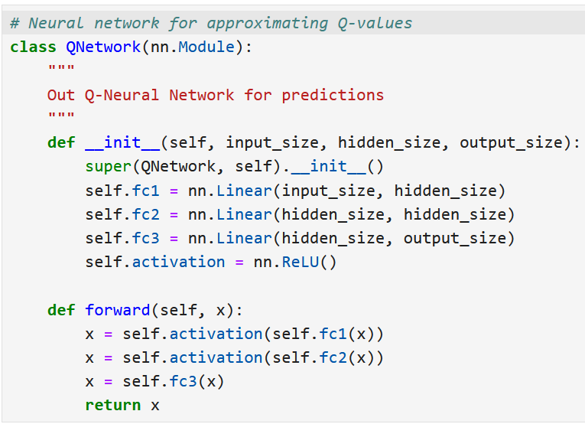
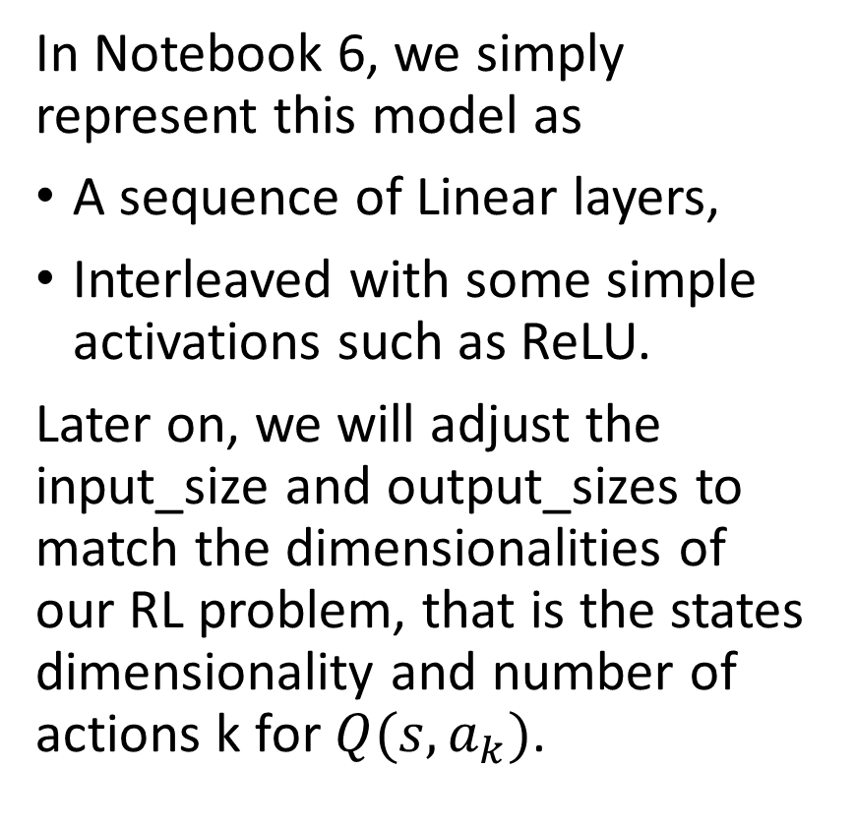
Using a NN model as a Q-function
In Notebook 6, we simply represent this model as
A sequence of Linear layers,
Interleaved with some simple activations such as ReLU.
Later on, we will adjust the input_size and output_sizes to match the dimensionalities of our RL problem, that is the states dimensionality and number of actions k for $Q(s,a_{k})$.

Slide 8
Using a NN model as a Q-function
Next, we define our Deep Q-Learning agent, which interacts with the environment and learns an optimal policy using a neural network. Our DQLAgent class represents an AI agent that:
Uses a deep neural network (Q-Network) to approximate Q-values.
Explores and exploits the environment.
Trains using Deep Q-Learning (DQL) by adjusting NN parameters to learn the optimal Q-values, so that the RL agent policy is able to find the optimal actions to use in any given state.
Improves over time by balancing exploration and exploitation, with exploration rate decay.

Slide 9
Using a NN model as a Q-function
Next, we define our Deep Q-Learning agent, which interacts with the environment and learns an optimal policy using a neural network. Our DQLAgent class represents an AI agent that:
Uses a deep neural network (Q-Network) to approximate Q-values.
Explores and exploits the environment.
Trains using Deep Q-Learning (DQL) by adjusting NN parameters to learn the optimal Q-values, so that the RL agent policy is able to find the optimal actions to use in any given state.
Improves over time by balancing exploration and exploitation, with exploration rate decay.

Slide 10
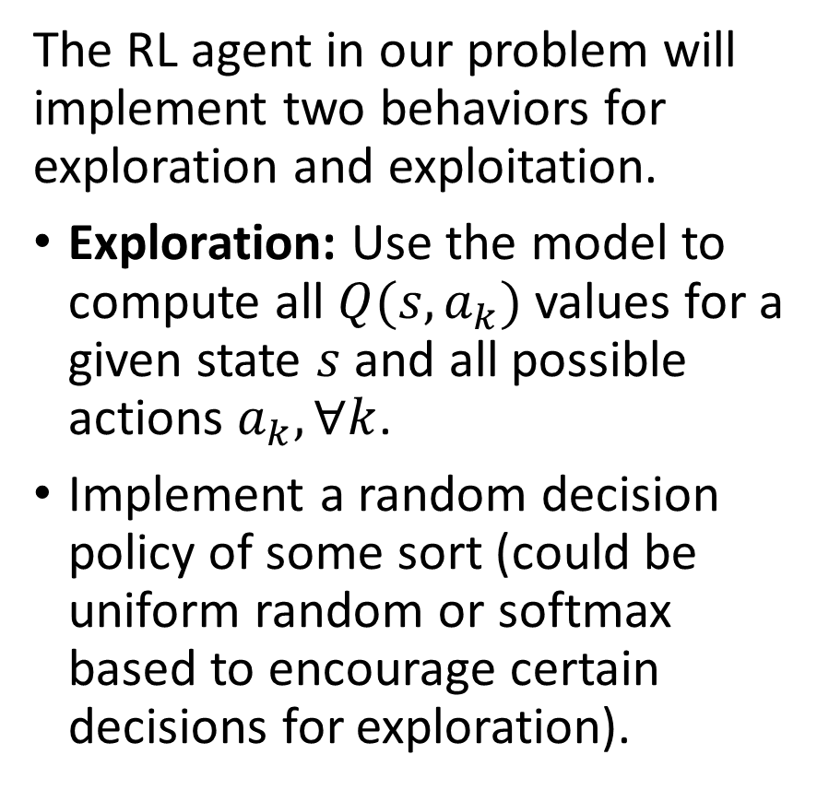
Using a NN model as a Q-function
The RL agent in our problem will implement two behaviors for exploration and exploitation.
Exploration: Use the model to compute all $Q(s,a_{k})$values for a given state $s$ and all possible actions $a_{k}, ∀k$.
Implement a random decision policy of some sort (could be uniform random or softmax based to encourage certain decisions for exploration).
State s
$$Q(s, a_{1})$$
𝑄(𝑠, 𝑎_1)
$$Q(s, a_{2})$$
𝑄(𝑠, 𝑎_2)
$$Q(s, a_{N})$$
𝑄(𝑠, 𝑎_𝑁)
NN Model
…

Slide 11
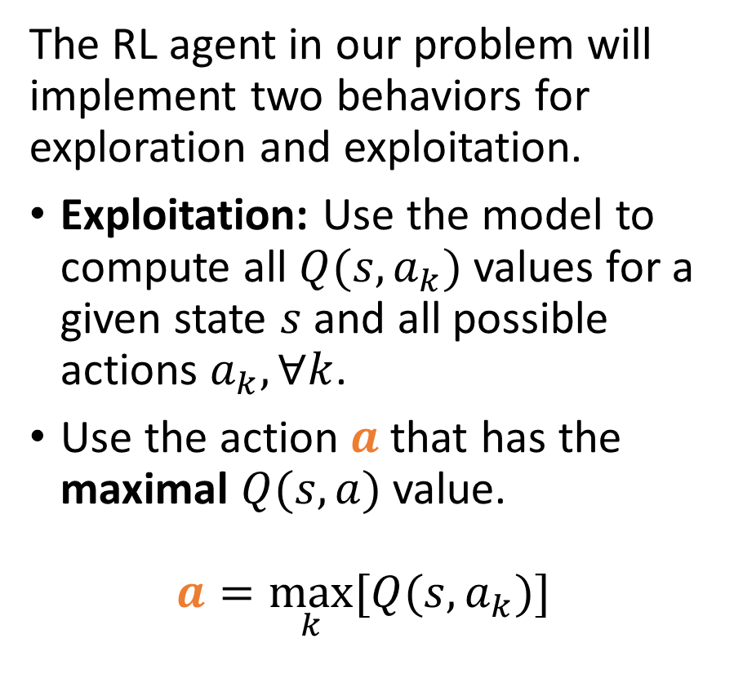
Using a NN model as a Q-function
The RL agent in our problem will implement two behaviors for exploration and exploitation.
Exploitation: Use the model to compute all $Q(s,a_{k})$values for a given state $s$ and all possible actions $a_{k}, ∀k$.
Use the action $a$ that has the maximal $Q(s,a)$ value.
$$a=\max_{k}{[Q(s,a_{k})]}$$
State s
$$Q(s, a_{1})$$
𝑄(𝑠, 𝑎_1)
$$Q(s, a_{2})$$
𝑄(𝑠, 𝑎_2)
$$Q(s, a_{N})$$
𝑄(𝑠, 𝑎_𝑁)
NN Model
…

Slide 12
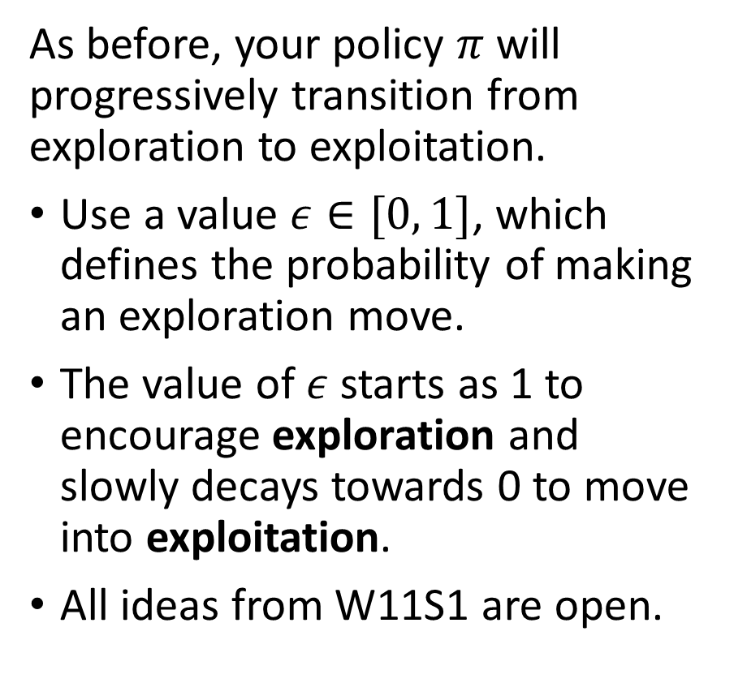
Using a NN model as a Q-function
As before, your policy $π$ will progressively transition from exploration to exploitation.
Use a value $ε∈[0, 1]$, which defines the probability of making an exploration move.
The value of $ε$ starts as 1 to encourage exploration and slowly decays towards 0 to move into exploitation.
All ideas from W11S1 are open.
State s
$$Q(s, a_{1})$$
𝑄(𝑠, 𝑎_1)
$$Q(s, a_{2})$$
𝑄(𝑠, 𝑎_2)
$$Q(s, a_{N})$$
𝑄(𝑠, 𝑎_𝑁)
NN Model
…

Slide 13
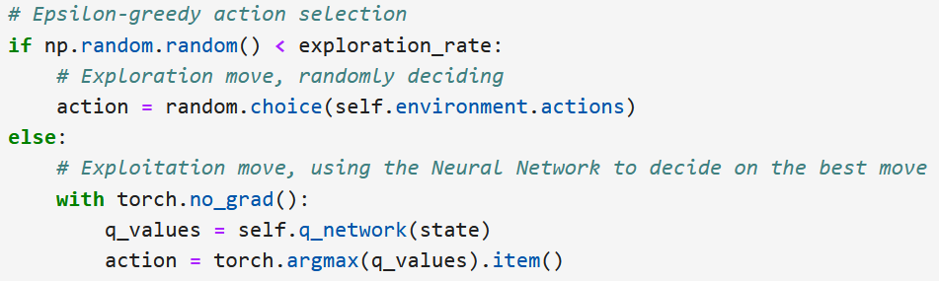
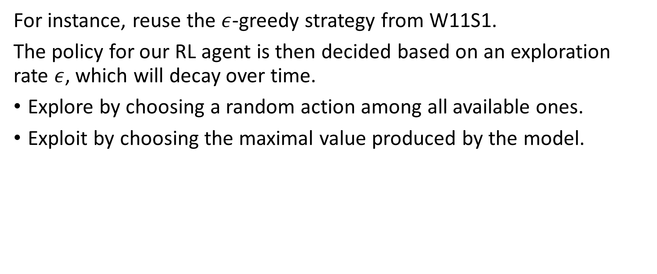
Using a NN model as a Q-function
For instance, reuse the $ε$-greedy strategy from W11S1.
The policy for our RL agent is then decided based on an exploration rate $ε$, which will decay over time.
Explore by choosing a random action among all available ones.
Exploit by choosing the maximal value produced by the model.

Slide 14
Using a NN model as a Q-function
Next, we define our Deep Q-Learning agent, which interacts with the environment and learns an optimal policy using a neural network. Our DQLAgent class represents an AI agent that:
Uses a deep neural network (Q-Network) to approximate Q-values.
Explores and exploits the environment.
Trains using Deep Q-Learning (DQL) by adjusting NN parameters to learn the optimal Q-values, so that the RL agent policy is able to find the optimal actions to use in any given state.
Improves over time by balancing exploration and exploitation, with exploration rate decay.

Slide 15
Using a NN model as a Q-function
Question: How would we train this model so that it learns to produce a good approximation for the Q values?
Earlier, we had a Q-learning update formula, but it worked by adjusting the Q values in a Q-table directly.
Here, we have to find a way to adjust the NN model parameters to improve the Q-values indirectly.

Slide 16
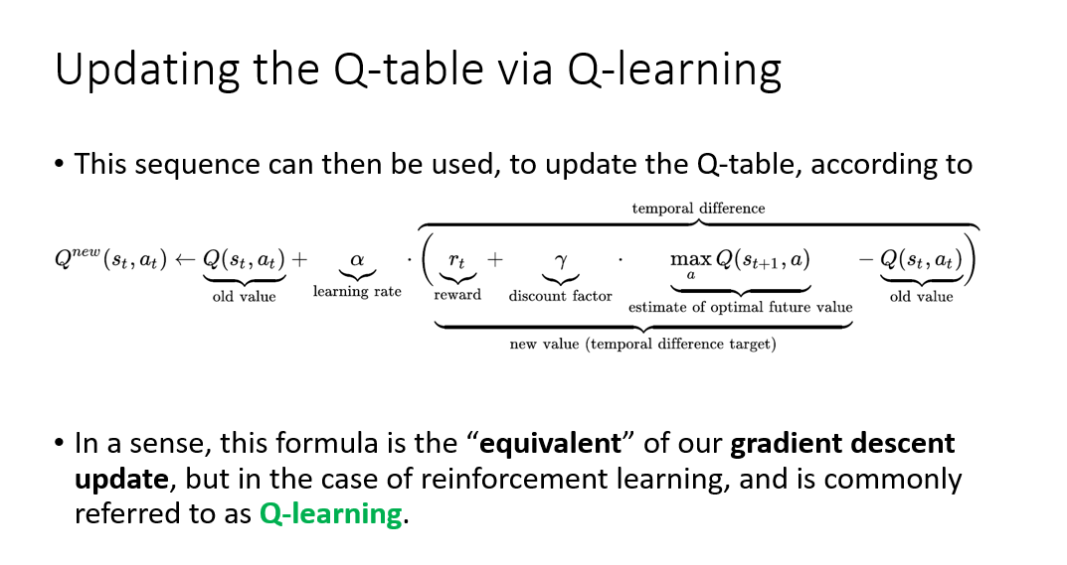
Using a NN model as a Q-function
Previously: When we had access to a Q-table and wanted to update its values, we would use the Q-learning formula, shown below.

Slide 17
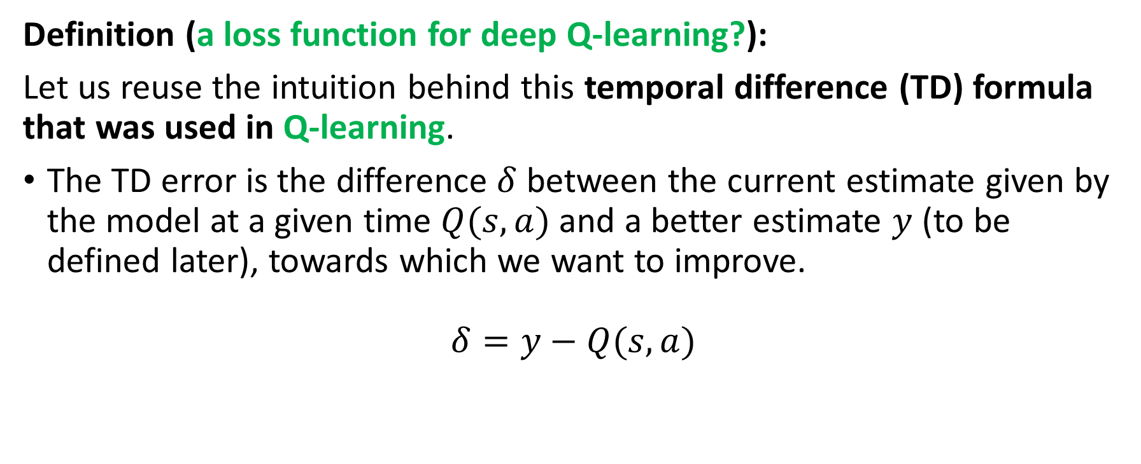
Using a NN model as a Q-function
Definition (a loss function for deep Q-learning?):
Let us reuse the intuition behind this temporal difference (TD) formula that was used in Q-learning.
The TD error is the difference $δ$ between the current estimate given by the model at a given time $Q(s, a)$ and a better estimate $y$ (to be defined later), towards which we want to improve.
$$δ=y−Q(s,a)$$

Slide 18
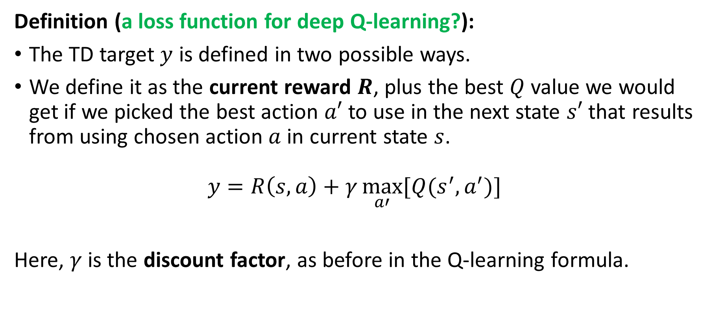
Using a NN model as a Q-function
Definition (a loss function for deep Q-learning?):
The TD target $y$ is defined in two possible ways.
We define it as the current reward $R$, plus the best $Q$ value we would get if we picked the best action $a′$ to use in the next state $s′$ that results from using chosen action $a$ in current state $s$.
$$y=R\left(s,a\right)+γ\max_{a′}{[Q(s^{′}, a^{′})]}$$
Here, $γ$ is the discount factor, as before in the Q-learning formula.

Slide 19
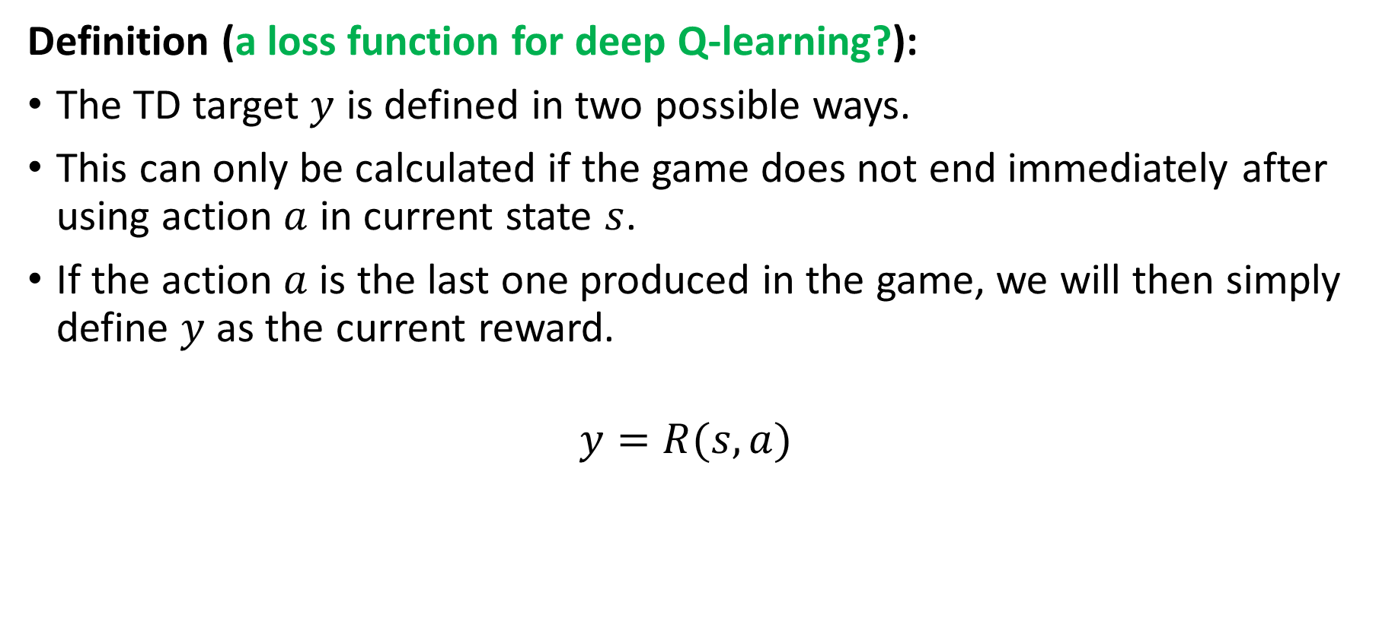
Using a NN model as a Q-function
Definition (a loss function for deep Q-learning?):
The TD target $y$ is defined in two possible ways.
This can only be calculated if the game does not end immediately after using action $a$ in current state $s$.
If the action $a$ is the last one produced in the game, we will then simply define $y$ as the current reward.
$$y=R(s,a)$$

Slide 20
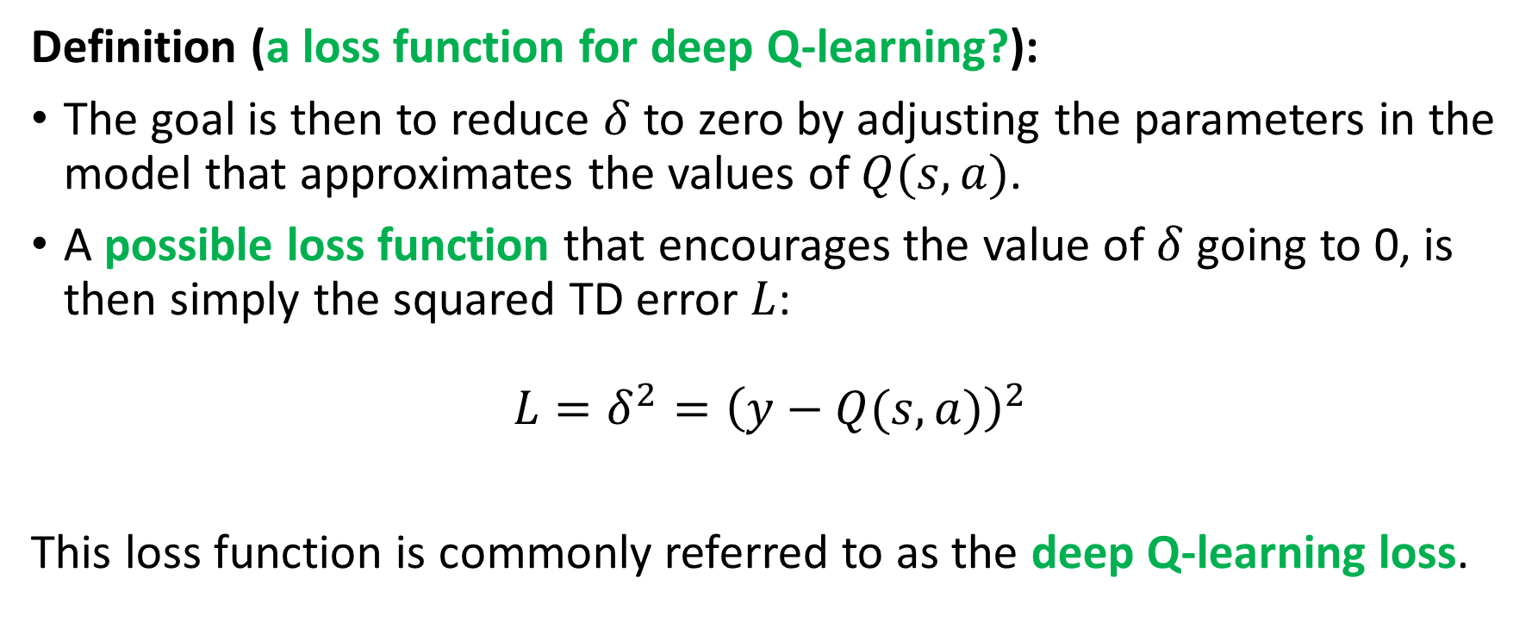
Using a NN model as a Q-function
Definition (a loss function for deep Q-learning?):
The goal is then to reduce $δ$ to zero by adjusting the parameters in the model that approximates the values of $Q(s,a)$.
A possible loss function that encourages the value of $δ$ going to 0, is then simply the squared TD error $L$:
$$L=δ^{2}={\left(y−Q(s,a)\right)}^{2}$$
This loss function is commonly referred to as the deep Q-learning loss.

Slide 21
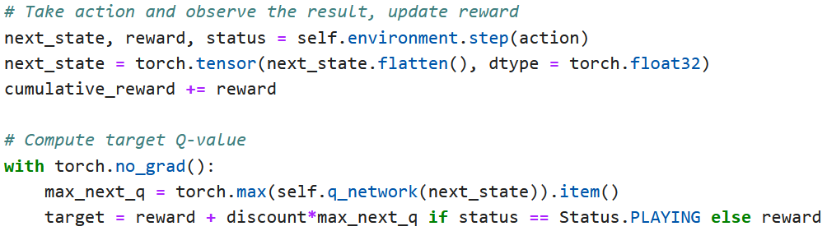

Implementing our loss function and training
Following the mathematical intuition about the TD loss, we can implement the loss function$L$ as shown below.

Slide 22
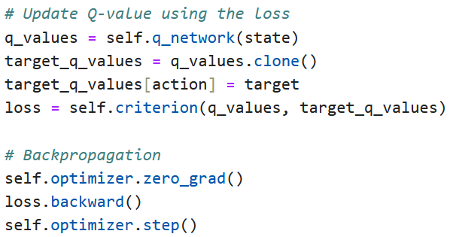

Implementing our loss function and training
Following the mathematical intuition about the TD loss, we can implement the loss function$L$ as shown below.
Then, trust that the autograd and optimizer.step() will do the job!

Slide 23
Using a NN model as a Q-function
Next, we define our Deep Q-Learning agent, which interacts with the environment and learns an optimal policy using a neural network. Our DQLAgent class represents an AI agent that:
Uses a deep neural network (Q-Network) to approximate Q-values.
Explores and exploits the environment.
Trains using Deep Q-Learning (DQL) by adjusting NN parameters to learn the optimal Q-values, so that the RL agent policy is able to find the optimal actions to use in any given state.
Improves over time by balancing exploration and exploitation, with exploration rate decay (and we keep track of training performance!)

Slide 24
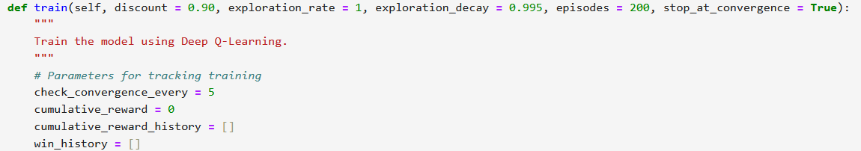

Training procedure
Initialize hyperparameters for RL agent (discount coefficient $γ$, exploration rate $ε$ initial value and decaying factor, number of episodes the agent will play the game, etc.)
Initialize rewards and performance metrics to track training.

Slide 25
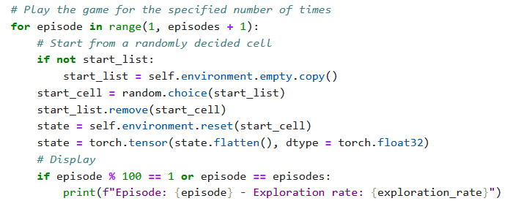
Training procedure
Play the game a certain number of times, resetting the environment every time and choosing a random starting point (why not necessarily the same one every time?)

Slide 26
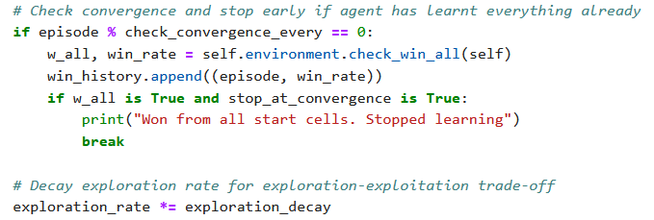
Training procedure
At the end of each episode, adjust the exploration rate (decay) and check if there is a convergence on the model learning (early stopping).

Slide 27
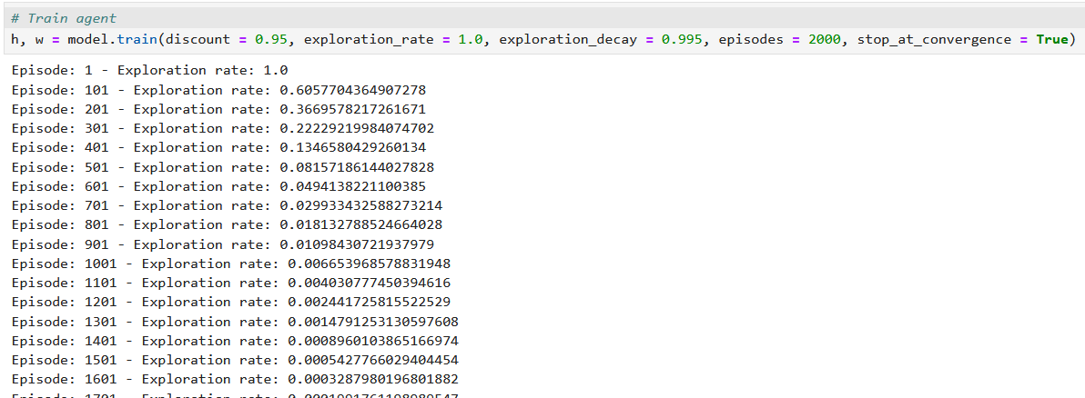
Training procedure
Run the trainer function and see exploration rate decay to 0.

Slide 28
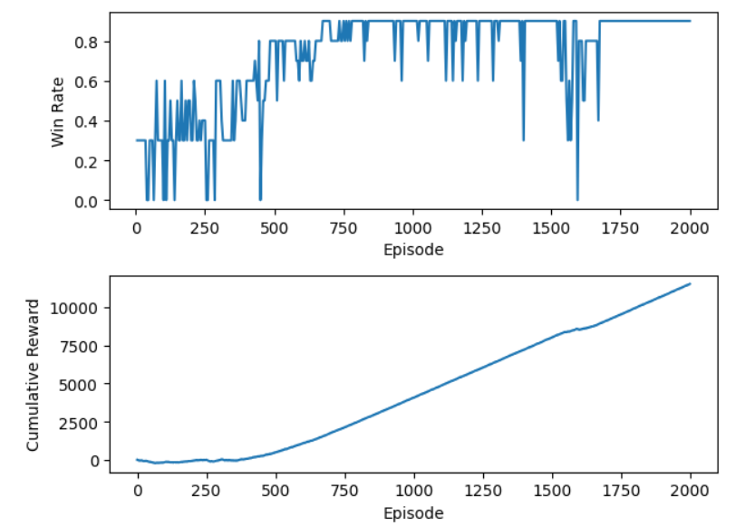
Post-training Evaluation
Display some training curves, showing for instance the evolution of the win rate (ability to reach the exit every time) over training episodes.

Slide 29
Post-training Evaluation
Display some training curves, showing an increase of cumulative rewards over training episodes (hence indicating that the agent is attempting/learning to maximize rewards).

Slide 30
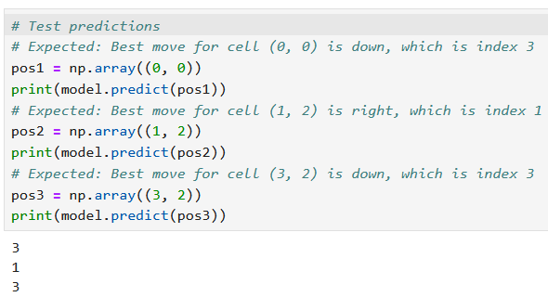
Post-training Evaluation
Test the model
For instance, you can ask the model to make an exploitation move in specific locations of the maze and confirm that the agent has indeed learnt to find the shortest path to the exit.

Slide 31
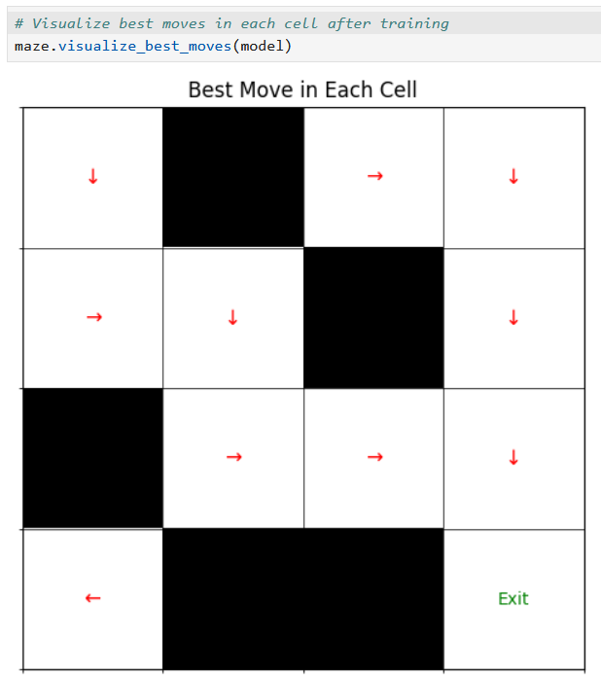
Post-training Evaluation
Test the model
For instance, you can ask the model to make an exploitation move in specific locations of the maze and confirm that the agent has indeed learnt to find the shortest path to the exit.

Slide 32
Post-training Evaluation
There are however cells that are still problematic, e.g. cell (0, 3).
Not the end of the world given that this cell is impossible to reach from start cell (0, 0).
This suggests that the Deep-Q-Learning agent has more to learn about the maze game.
Yet, it was able to learn the shortest path from (0, 0) to (3, 3)!

Slide 33
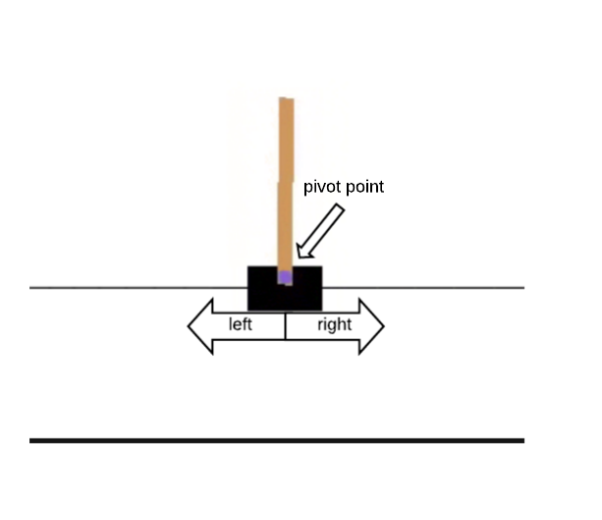
A more difficult example (shown, but implementation out of the scope of this class)
Example: the cart-pole problem, a.k.a. learning to balance objects.
State: our current visualization of the cart (image that the RL model has to process).
Actions: go left or go right at a fixed speed.
Reward: +1 for each unit of time where the cart does not leave the screen and the pole does not fall below a certain angle.
Next state generation: cart and pole both follow simple programmed rules of physics.

Slide 34
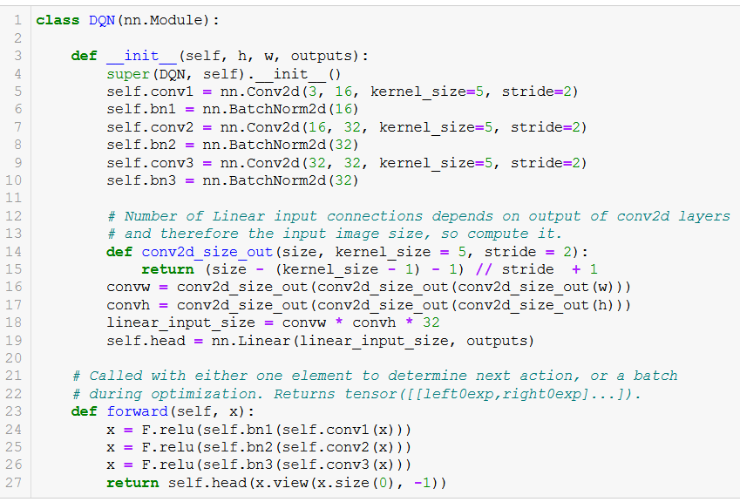
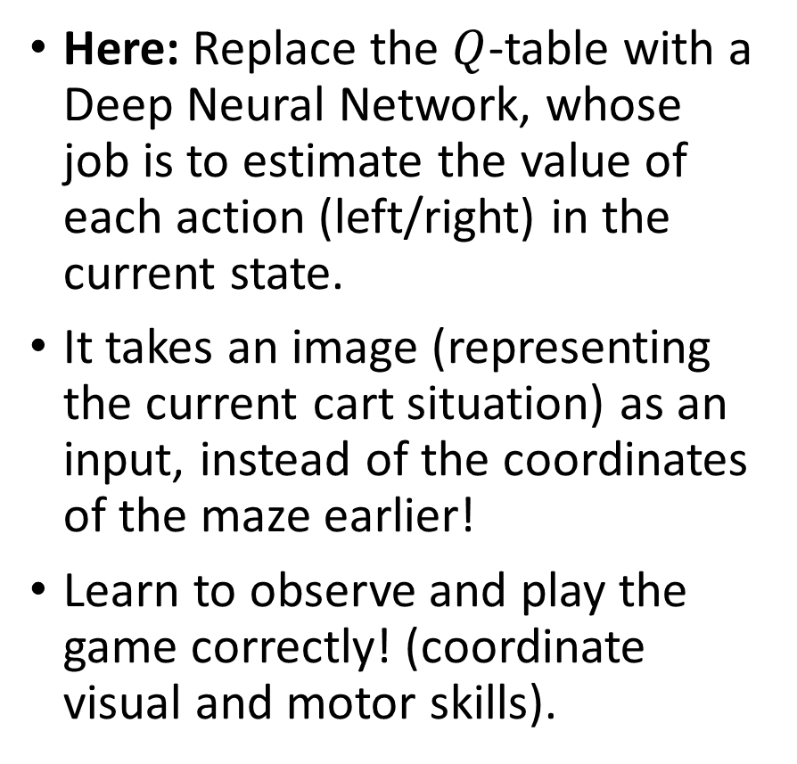
A more difficult example (shown, but implementation out of the scope of this class)
Here: Replace the $Q$-table with a Deep Neural Network, whose job is to estimate the value of each action (left/right) in the current state.
It takes an image (representing the current cart situation) as an input, instead of the coordinates of the maze earlier!
Learn to observe and play the game correctly! (coordinate visual and motor skills).

Slide 35
A more difficult example (shown, but implementation out of the scope of this class)
Same principle as before with the Deep Q-learning procedure as before, but more complex due to:
Image processing
Physics-based environment
Need for experience replay (need to see the full episode for one instance of training)

Slide 36
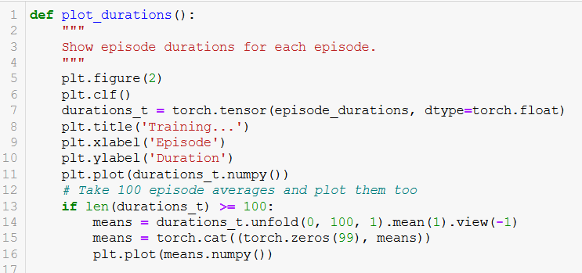
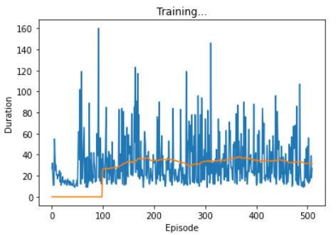
Training results
Same principle as before with the Deep Q-learning procedure as before, but more complex due to:
Image processing
Physics-based environment
Need for experience replay
But agent will eventually learn to keep the stick balanced for a solid 30 seconds on average!

Slide 37
Applications following this cart-pole example
Train an AI to keep a robot on its feet, despite some “minor environment perturbations” (a polite way of saying you kick the hell out of the robot for fun).
Video: https://www.youtube.com/watch?v=NR32ULxbjYc
BostonDynamics blog: https://blog.bostondynamics.com/

Slide 38
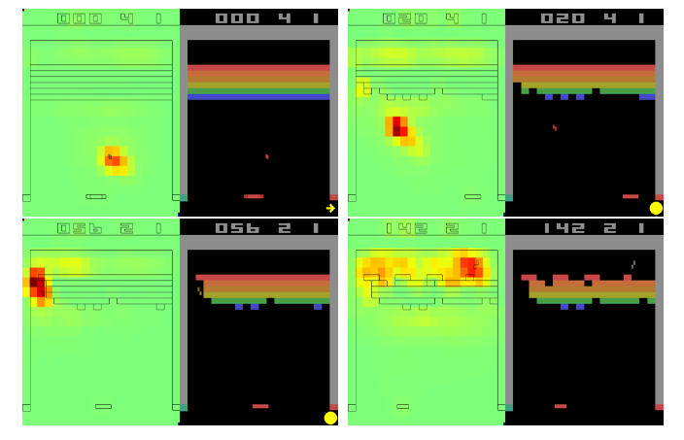
Applications following this cart-pole example
Train an AI to play video games with Deep Reinforcement Learning (Mnih, 2013)!
Paper: https://www.cs.toronto.edu/~vmnih/docs/dqn.pdf
Video: https://www.youtube.com/watch?v=TmPfTpjtdgg

Slide 39
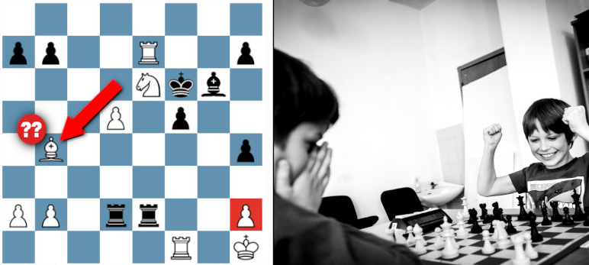
Let us start with a new problem
Problem: Traditional RL relies on hand-crafted rewards… But in many real-world tasks:
Reward function is often hard to define (chess, language, etc.)
Human preferences matter more (e.g., dialogue, summarization).
For instance, how would you estimate that a given chess move is brilliant? Or a blunder?
Is there a reliable close-form expression for this?

Slide 40
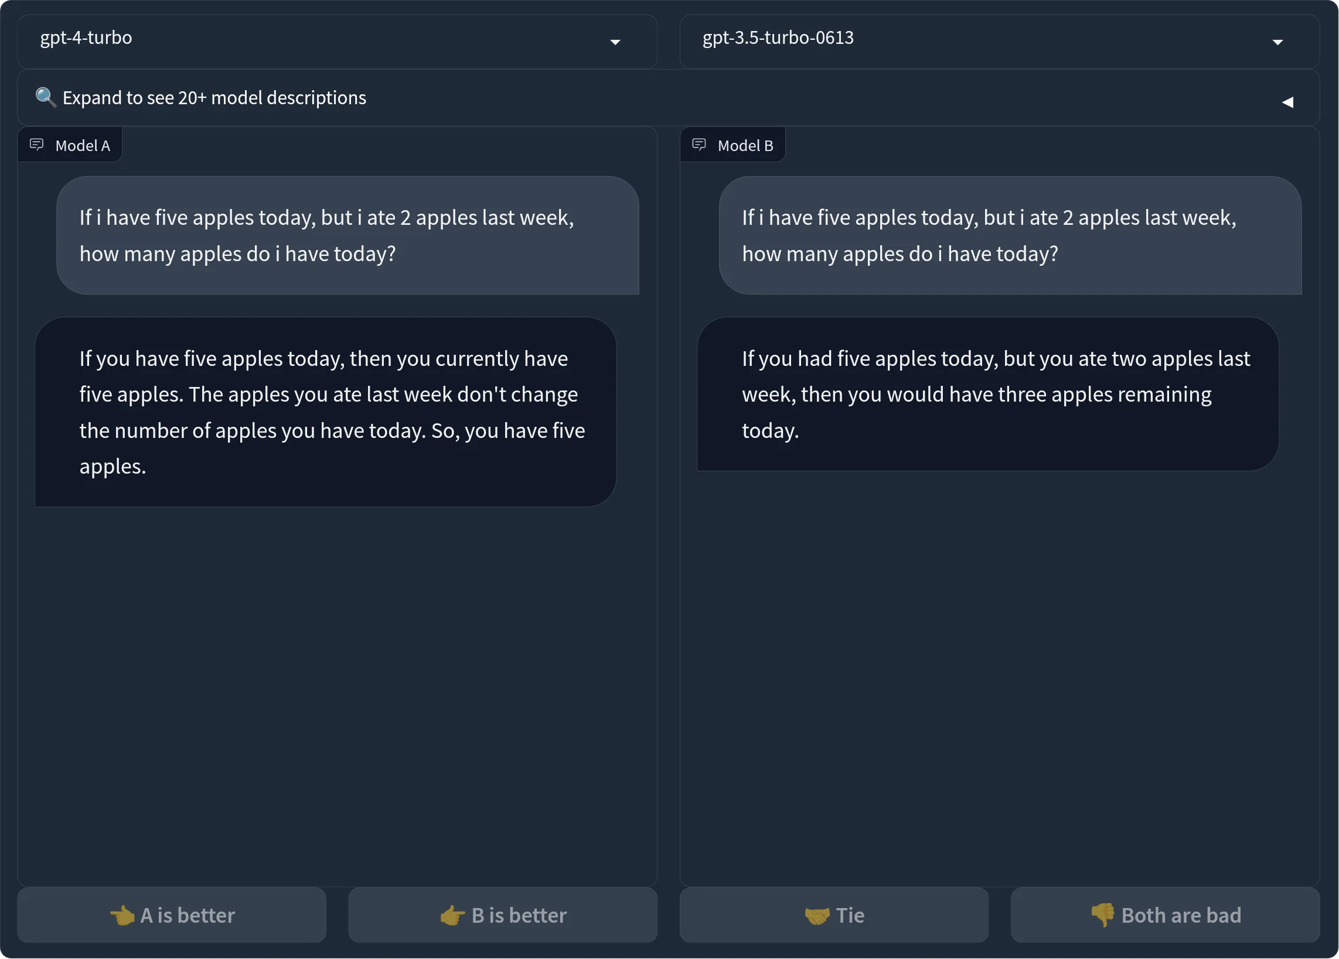
Let us start with a problem
Problem: Traditional RL relies on hand-crafted rewards… But in many real-world tasks:
Reward function is often hard to define (chess, language, etc.)
Human preferences matter more (e.g., dialogue, summarization).
What closed-form metric can you use to evaluate the quality of a chatbot answer?

Slide 41
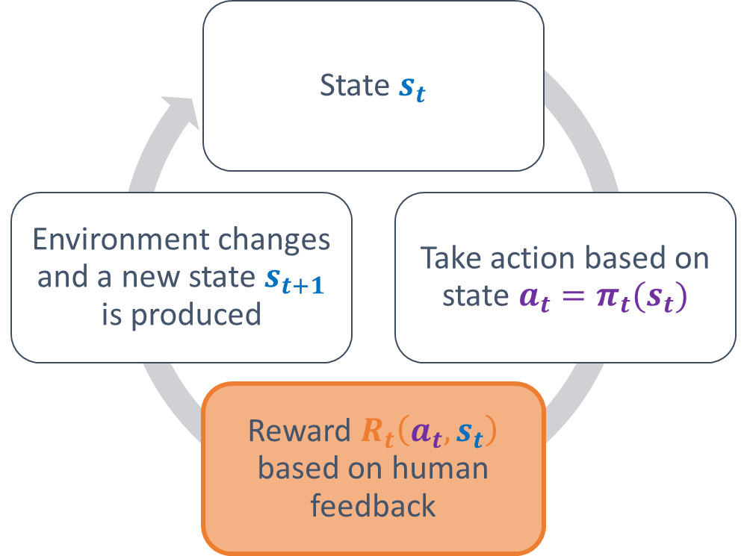
RLHF: a definition
Definition (Reinforcement Learning with Human Feedback):
Reinforcement Learning with Human Feedback (RLHF) enables learning from human judgment instead of static reward functions.
In layman terms, it replaces the traditional closed-form reward function with human-in-the-loop evaluation, which the agent will then use as a reward/feedback during training.

Slide 42
Our RLHF toy example
Our toy example is implemented in Notebook 7.
Objective: Let us imagine that we are building a chatbot that needs to respond to user queries intelligently.
State: Think of this as a chat simulation where a user greets the chatbot first before asking a question. The embedding of the user query plays the role of a state that the agent model receives as input.
(Here this will not matter as we will simply replace the user query by a random embedding, but let us pretend it represents the user query, but that could be changed as well. Leaving it to you as extra practice.)

Slide 43
Our RLHF toy example
Objective: Let us imagine that we are building a chatbot that needs to respond to user queries intelligently.
Actions: The chatbot then perceives the question as an embedding, which is a vector representation of the query. The chatbot then has four possible responses to choose from to greet the user.
“Hello, how can I help you?“
“What do you need?“
“Please clarify your question.“
“Hello lovely.“
(Note that in practice we would allow the model to generate answers, in the form of a sequence of some sort, but we keep it simple here.)

Slide 44
Our RLHF toy example
Reward: However, instead of training it on massive datasets, we decided to simulate an environment where the chatbot learns by trial and error, relying on human feedback to understand the quality of its answers, just like an agent in a reinforcement learning game.
Simulated human feedback: it would be cumbersome to have humans (you) rate the quality of the answers over and over again, so we will implement a simulated feedback engine that gives assigned score to each possible action.
"Hello, how can I help you?" (Score: 10)
"What do you need?" (Score: 5)
"Please clarify your question." (Score: 2)
"Hello lovely." (Score: 1)

Slide 45
Our RLHF toy example
Each response has a predefined feedback score, representing how good the answer is. The higher the score, the better the response. Let us pretend that this score is given by a user, after this user has been prompted to evaluate the quality of the chatbot answer, using a satisfaction score between 0 and 10.
This environment allows an AI agent to practice choosing responses, receiving feedback from humans in the form of a score, and learning from its mistakes.
Over time, the chatbot could use reinforcement learning techniques (like deep Q-learning) to improve its ability to pick the best response based on the query embeddings.

Slide 46
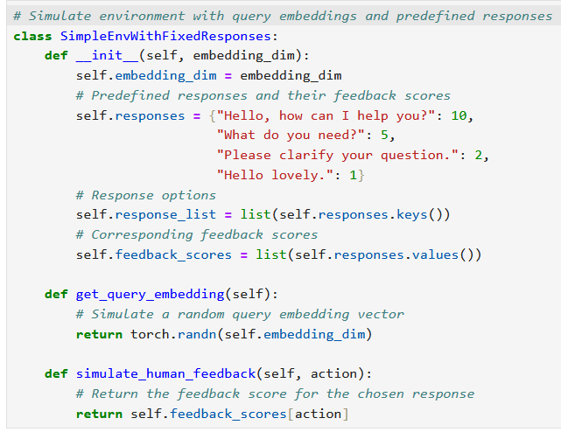
A simple chatbot environment
We start by defining a way to:
Generate random embeddings for user queries: we will simply pretend that these represent the queries of a user.
Simulate human feedback to each possible answer: This simply draws values from a dictionary, but would have to be replaced by actual human feedback to make this RLHF.

Slide 47
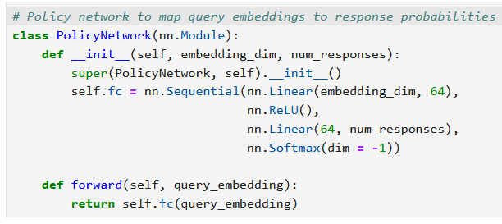
A simple chatbot environment
Next, we define our RL agent.
It will be relying on a simple model that receives the embedding for the user query,
And then chooses the best answer to produce out of the four possible answers.
Simple linear model, as we are treating this as a classification task of some sort.

Slide 48
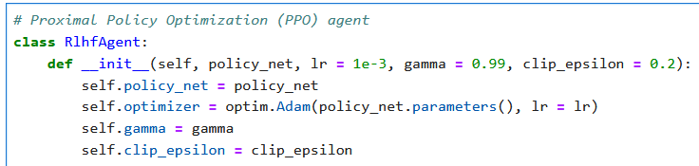
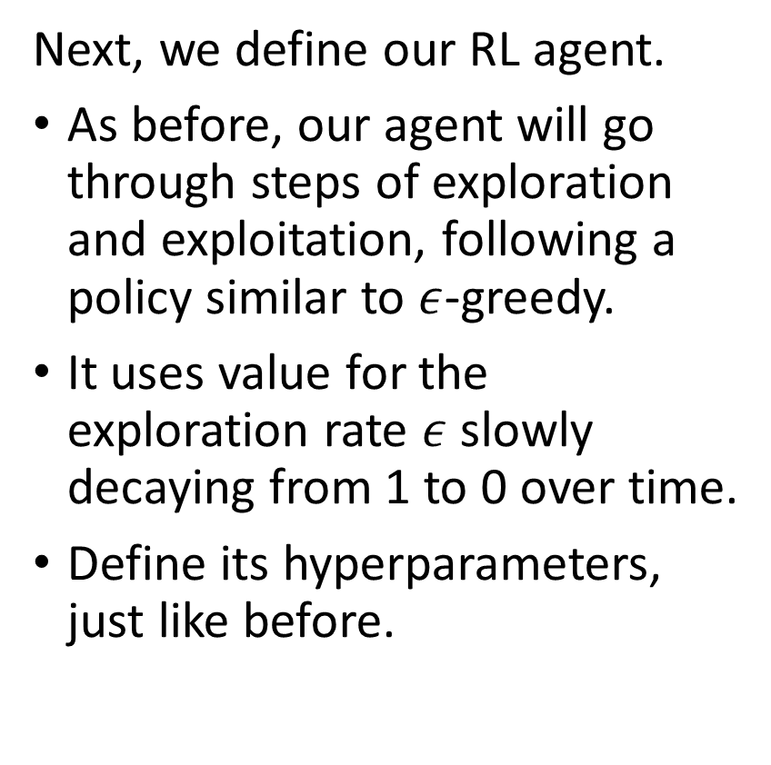
A simple chatbot environment
Next, we define our RL agent.
As before, our agent will go through steps of exploration and exploitation, following a policy similar to $ε$-greedy.
It uses value for the exploration rate $ε$ slowly decaying from 1 to 0 over time.
Define its hyperparameters, just like before.

Slide 49
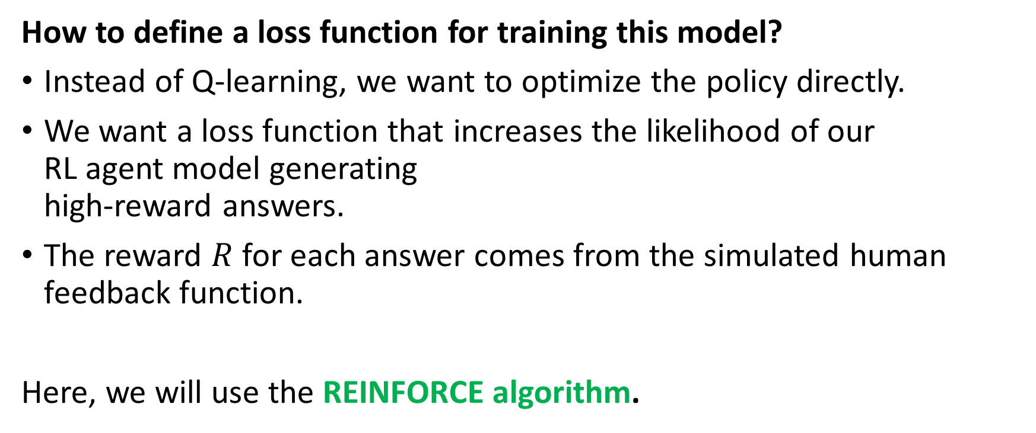
Training the RL agent model
How to define a loss function for training this model?
Instead of Q-learning, we want to optimize the policy directly.
We want a loss function that increases the likelihood of our RL agent model generating high-reward answers.
The reward $R$ for each answer comes from the simulated human feedback function.
Here, we will use the REINFORCE algorithm.

Slide 50
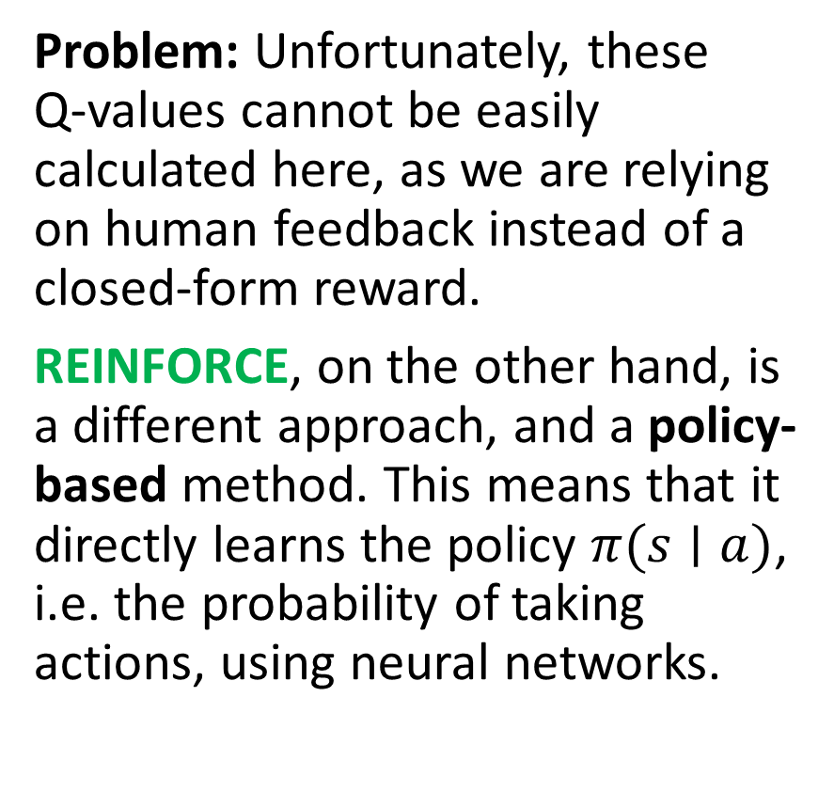
Training the RL agent model
Definition (REINFORCE algorithm):
REINFORCE is a policy gradient method used in reinforcement learning to directly learn the policy function that maps states to action probabilities.
Q-learning algorithms are value-based methods, meaning that they would learn how good an action is in terms of Q-values and attempts to choose actions based on these.
Problem: Unfortunately, these Q-values cannot be easily calculated here, as we are relying on human feedback instead of a closed-form reward.
REINFORCE, on the other hand, is a different approach, and a policy-based method. This means that it directly learns the policy $π(s∣a)$, i.e. the probability of taking actions, using neural networks.

Slide 51
REINFORCE Algorithm Breakdown
REINFORCE goes through the following steps
Step 1 - Collect Rollouts: Run the current policy in the environment and collect history (states, actions taken, rewards, and log probabilities of actions) on each played episode.

Slide 52
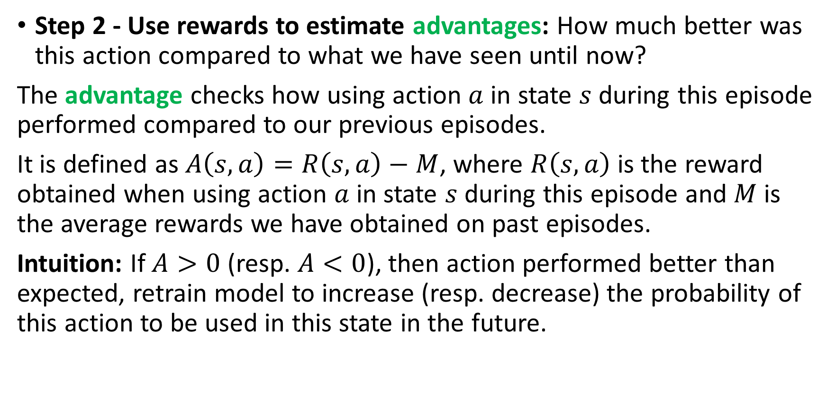
REINFORCE Algorithm Breakdown
Step 2 - Use rewards to estimate advantages: How much better was this action compared to what we have seen until now?
The advantage checks how using action $a$ in state $s$ during this episode performed compared to our previous episodes.
It is defined as $A\left(s,a\right)=R\left(s,a\right)−M$, where $R\left(s,a\right)$ is the reward obtained when using action $a$ in state $s$ during this episode and $M$ is the average rewards we have obtained on past episodes.
Intuition: If $A>0$ (resp. $A<0$), then action performed better than expected, retrain model to increase (resp. decrease) the probability of this action to be used in this state in the future.

Slide 53
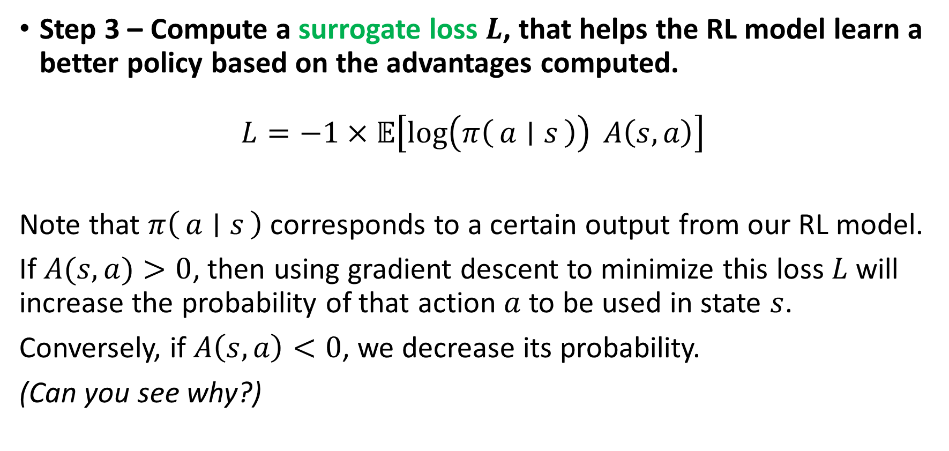
REINFORCE Algorithm Breakdown
Step 3 – Compute a surrogate loss $L$, that helps the RL model learn a better policy based on the advantages computed.
$$L=−1×𝔼\left[\log\left(π\left(a ∣ s\right)\right) A\left(s, a\right)\right]$$
Note that $π\left(a ∣ s\right)$ corresponds to a certain output from our RL model.
If $A(s,a)>0$, then using gradient descent to minimize this loss $L$ will increase the probability of that action $a$ to be used in state $s$.
Conversely, if $A\left(s,a\right)<0$, we decrease its probability.
(Can you see why?)

Slide 54
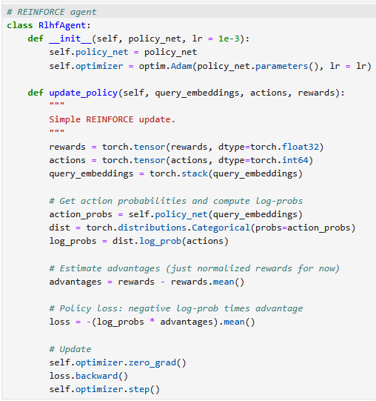
Define agent, by providing the model used to calculate policies.
One update requires to know the query embeddings (state), action and reward obtained on this episode.
Compute the log probabilities, advantages and the loss function.
Backpropagate with Adam just like before.

Slide 55
Training the RL agent
With everything set up (the chat environment, the policy network, and the REINFORCE agent), we can now train our chatbot using Reinforcement Learning with Human Feedback (RLHF).
Our trainer function uses 500 training episodes, where the chatbot repeatedly receives query embeddings, selects responses based on its policy, and gets human-like feedback. Each action probability is stored to compare past and new policies.
Every 10 interactions, the REINFORCE algorithm updates the policy model, refining how it maps queries to responses. Over time, the chatbot improves its response selection, in an attempt of maximizing the rewards it obtains.

Slide 56
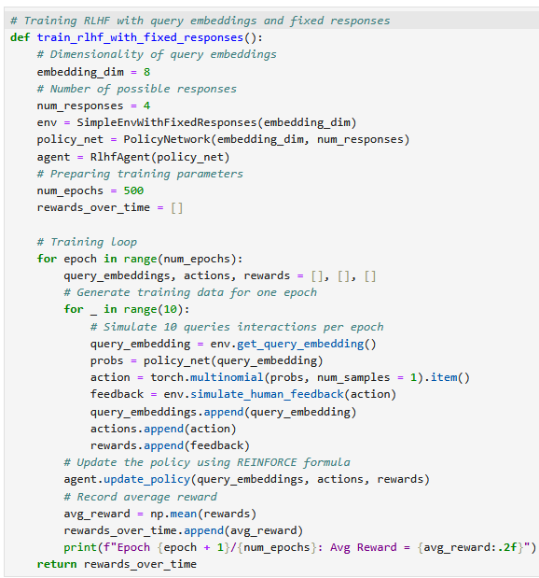
Define environment, agent, models and training parameters
Play the game 10 times over 500 iterations (10 episodes per iteration, one update every 10 episodes)
Log the outcomes of each episode (states, actions, rewards)
Update model using REINFORCE process
Display

Slide 57
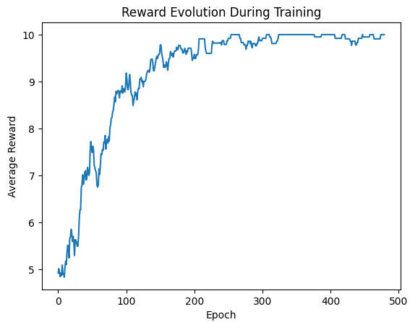
It trains!
The model is able to train!
It learns to choose the correct action (i.e. the one answer) that maximizes the possible reward (which is 10).
In practice, however, we would replace the automated reward system, with a human grading one, but it is costly in terms of human resources!

Slide 58
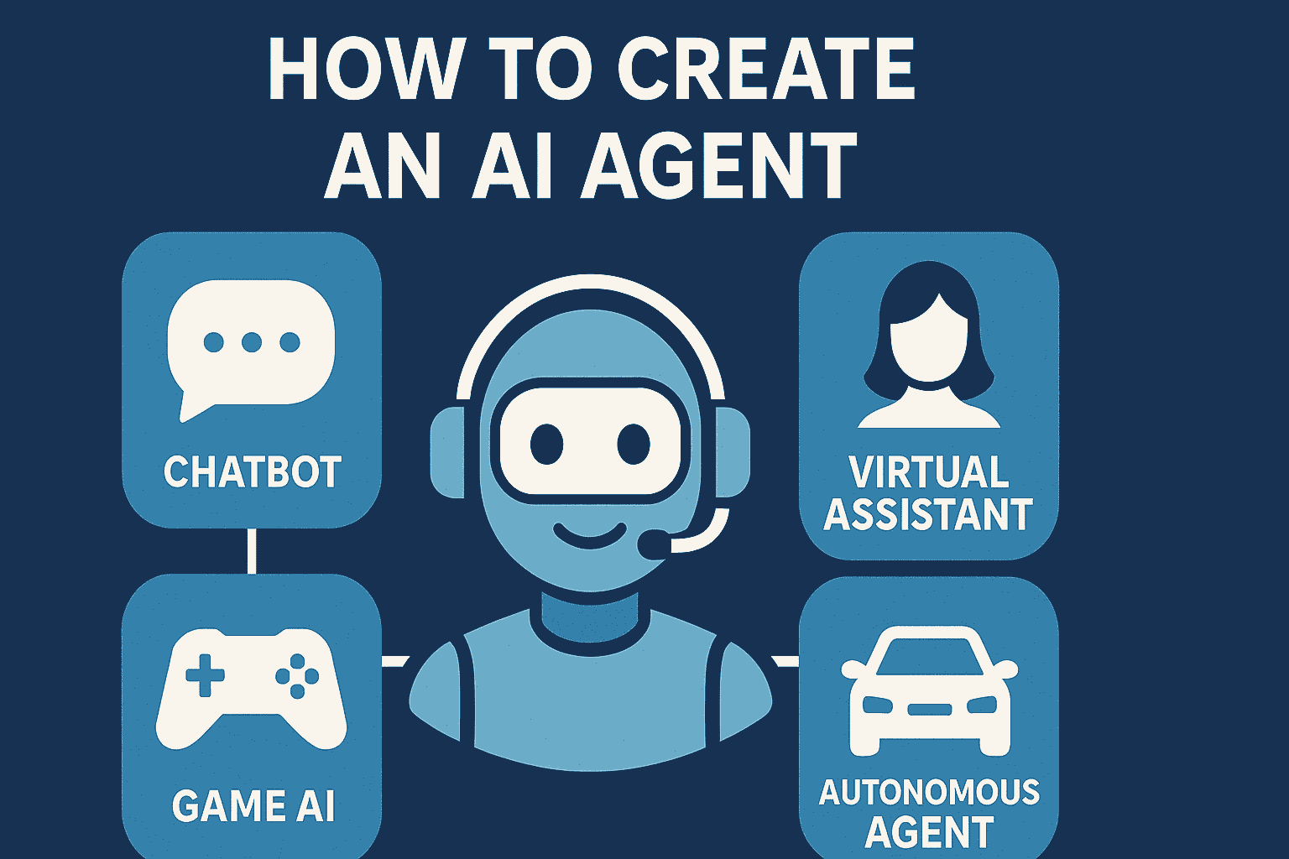
Applications of RLHF
Conversational AI and Chatbots: Fine-tunes language models like ChatGPT to align with human preferences in terms of answers.
Game AI and Virtual Assistants: Builds non-player characters (NPCs) or agents that adapt to human behaviour and feedback.
Ethical Decision-Making in AI: Applies human values to scenarios with no clear reward functions (e.g., moral dilemmas).

Slide 59
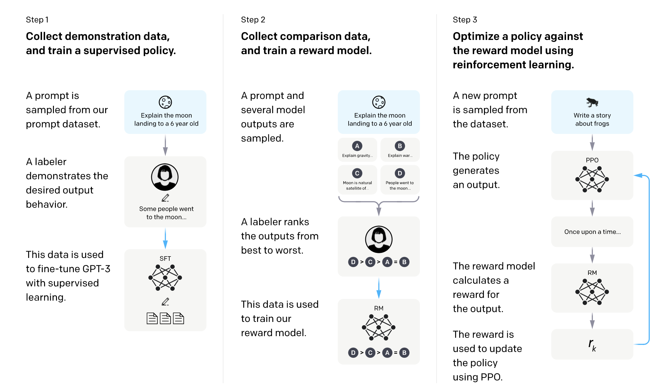
RLHF for ChatGPT fine-tuning? (Step 2)

Slide 60
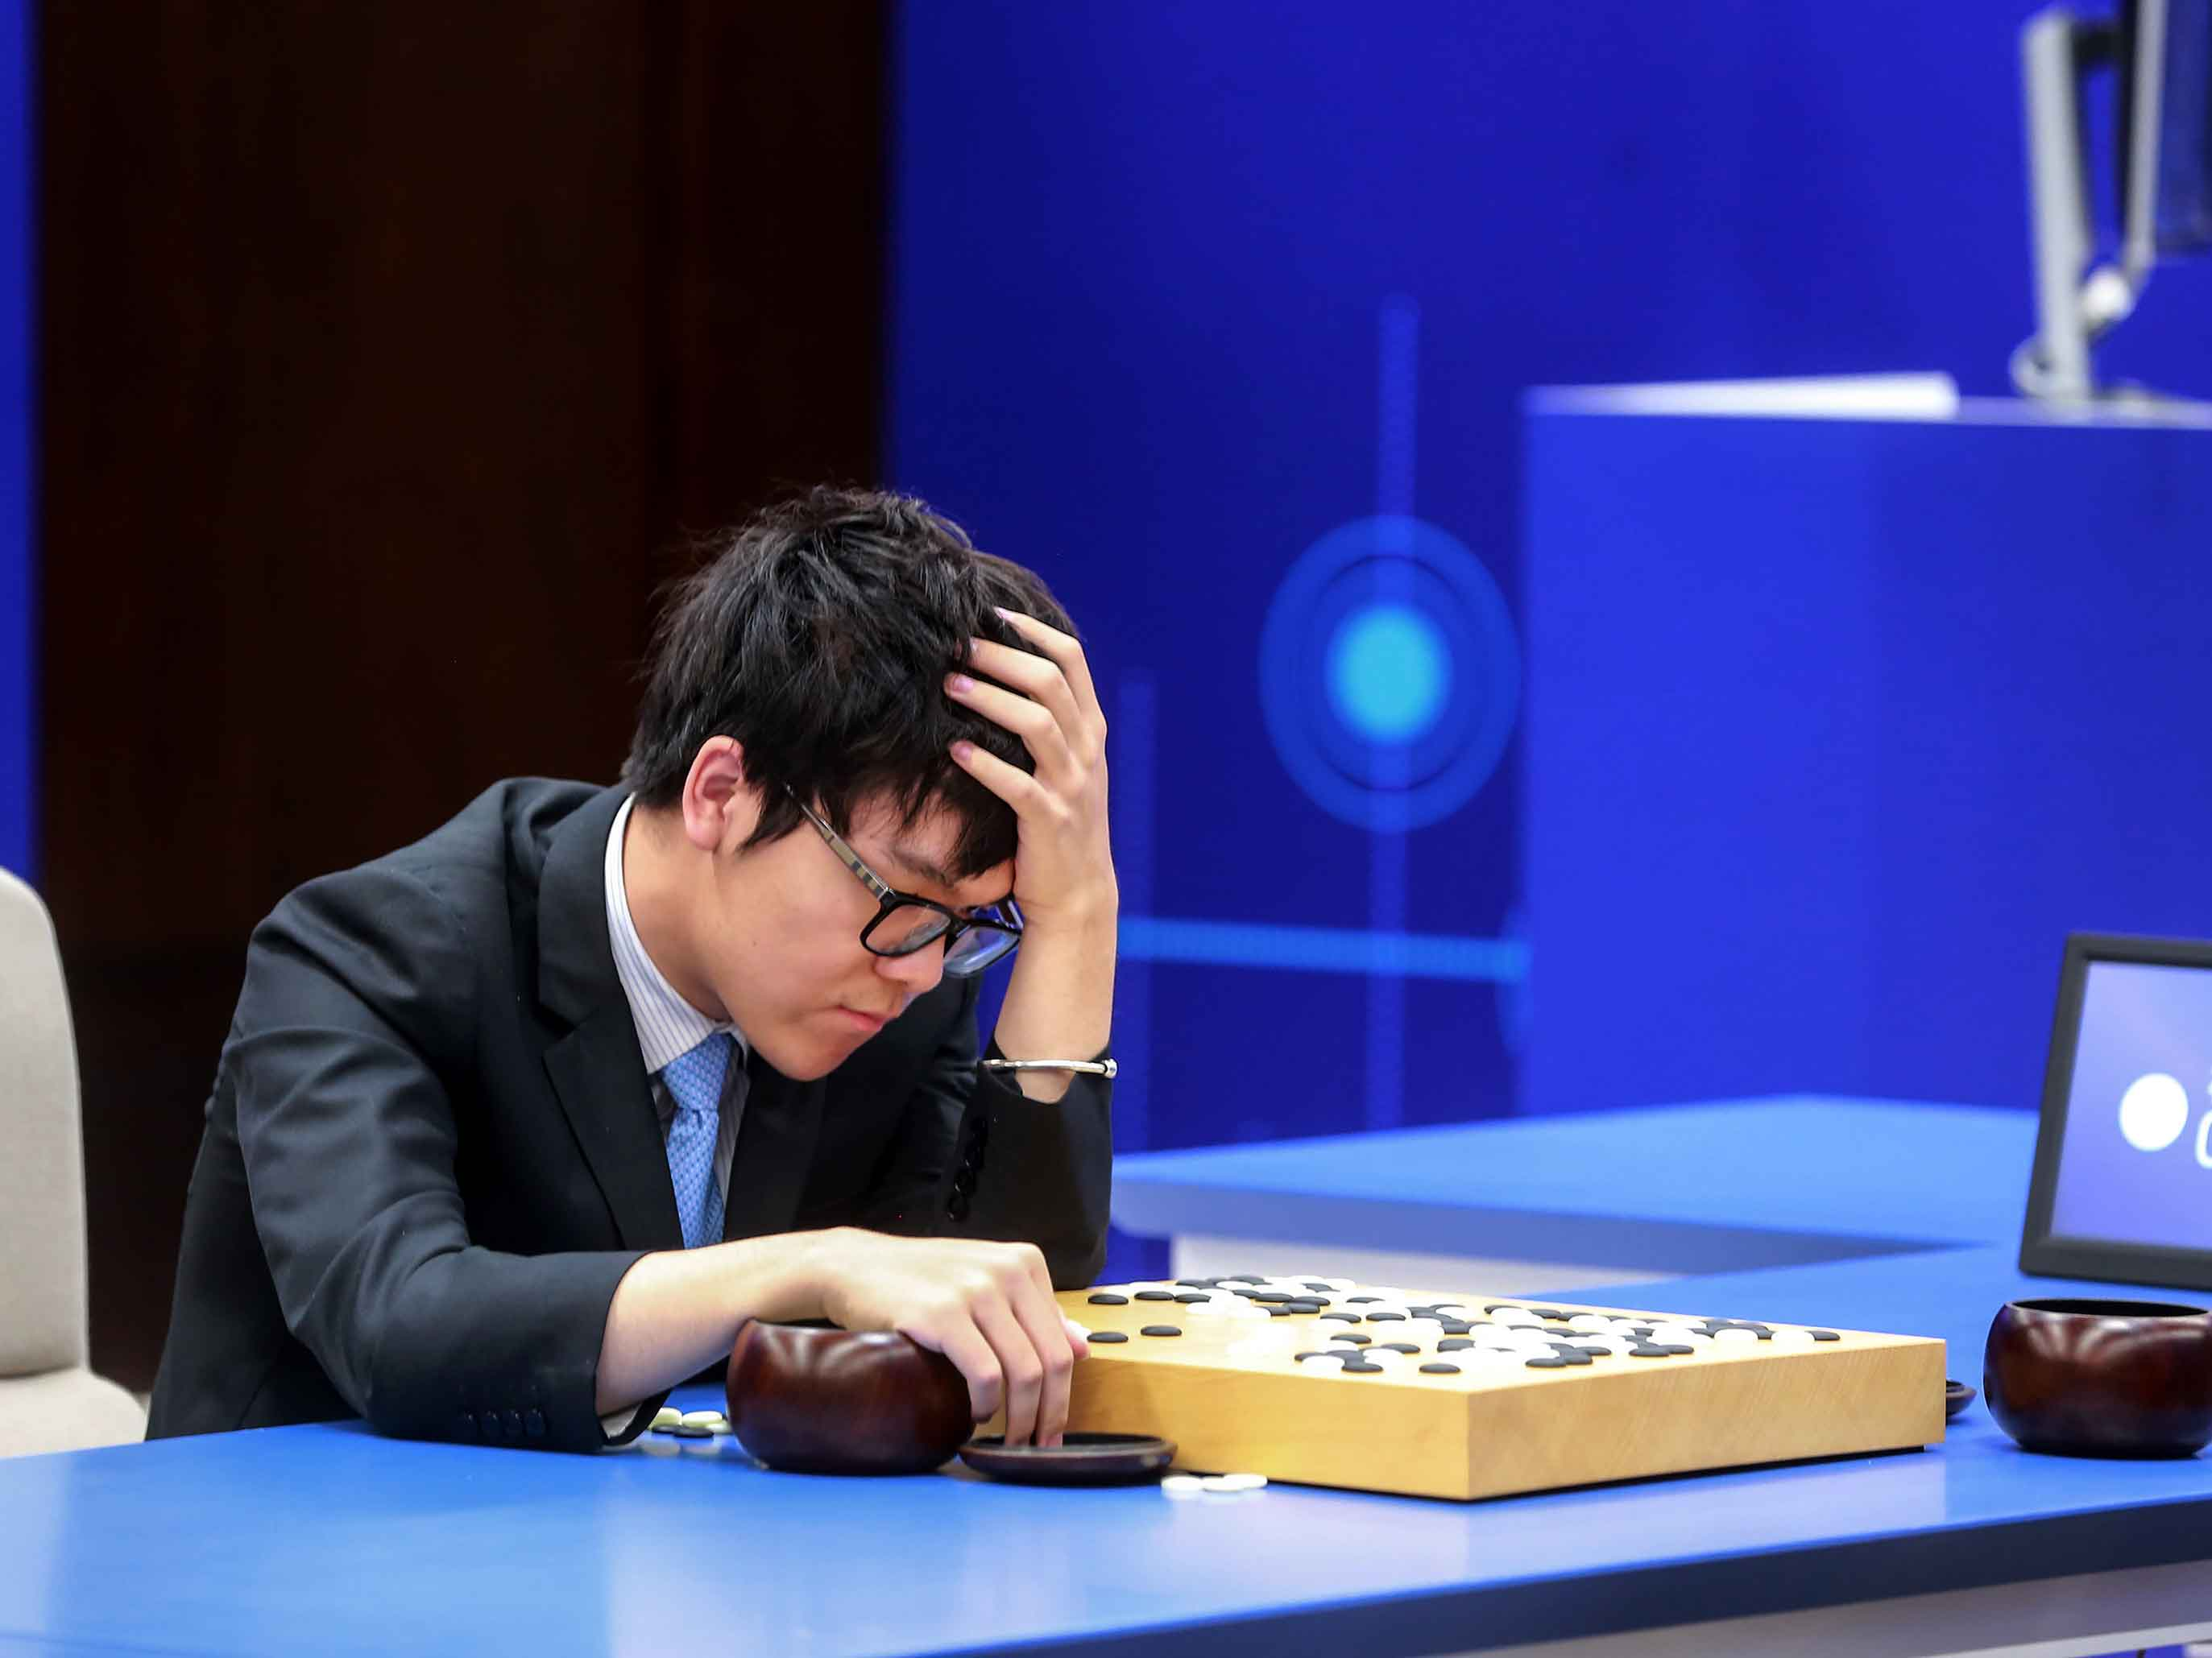
A quick word on actor-critic methods (more advanced stuff, out of scope)
In Deep Q-learning, we realized that most RL problems cannot have their Q functions or rewards computed easily.
Additional suggestion: Can the reward function always be computed?
→ Replace more elements of the RL system with Deep Neural Networks.

Slide 61

A quick word on actor-critic methods (more advanced stuff, out of scope)
Definition (actor-critic):
Actor-critic algorithms consist of two components.
Actor: a NN, whose purpose is to produce actions in response to given states, i.e. a policy. Can be trained as in Deep $Q$-learning or REINFORCE.
Critic: a NN, whose purpose is to evaluate the quality of the selected actions and suggesting directions for improvement, by defining a reward function or a $Q$ function or could replace human feedback.
In a sense, similar to the Generator-Critic pair of the Wasserstein GANs!
Generator: produce fake images.
Critic: evaluate said images.

Slide 62


From Deep Q learning to actor-critic

Slide 63
Actor-critic for ChatGPT fine-tuning? (Step 3)

Slide 64

Markov Decision Processes (more advanced stuff, out of scope)
Sometimes, the transition from state $s_{t}$ to next state $s_{t+1}$, following from action $a_{t}$, will not always be deterministic.
In that case, we have to define some system dynamics, as below.
$$p\left(s^{′},r | s,a\right)=P\left(s_{t+1}=s^{′}, r_{t}=r \right|{ s}_{t}=s, a_{t}=a)$$
Similar to our previous problem, with a stochastic twist.
It is called a Markov Decision Process (MDP) problem.

Slide 65

Markov Decision Processes (more advanced stuff, out of scope)
In MDPs, all the previous formulas have to be reworked to account for the stochastic aspect of the problem.
$$V_{t}^{π}\left(s\right)=E\left[G_{t} \right| s_{t}=s]$$
$$Q_{t}^{π}\left(s,a\right)=E\left[G_{t} \right| s_{t}=s, a_{t}=a]$$
In MDPs, the $Q$ and $V$ functions can still be learned from experience, but their Bellman equations change slightly, to account for the stochasticity.

Slide 66

Markov Decision Processes (more advanced stuff, out of scope)
In MDPs, the $Q$ and $V$ functions can still be learned from experience, but their Bellman equations change slightly, to account for the stochasticity.
$$V_{t}^{π}\left(s\right)=E\left[G_{t} \right| s_{t}=s]$$
$$V_{t}^{π}\left(s\right)=E\left[R_{t}+γG_{t+1} \right| s_{t}=s]$$
$$V_{t}^{π}\left(s\right)=\sum_{a}{π\left(a \right| s)\sum_{s′}{\sum_{r}{p\left(s^{′}, r \right| s,a) \left[r+γE\left[G_{t+1} | s_{t+1=s′}\right]\right]}}}$$
$$V_{t}^{π}\left(s\right)=\sum_{a}{π\left(a \right| s)\sum_{s′}{\sum_{r}{p\left(s^{′}, r \right| s,a) \left[r+γV_{t+1}^{π}\left(s′\right)\right]}}}$$

Slide 67

Partially observable MDP (more advanced stuff, out of scope)
Definition (partially observable Markov Decision Process):
In our original RL framework, we assumed that the agent was seeing the exact state of the game at each time t.
This is also an assumption, which can be challenged.
State $s_{t}$ is ground truth, agent received observation $o_{t}$ and uses to decide on action.
State
Take action based on observation
Reward is given for taking action in said state
Environment changes and a new state is produced
Observation is made by agent

Slide 68
Partially observable MDP (more advanced stuff, out of scope)
Definition (partially observable Markov Decision Process):
The agent then decides on an observation made of the actual (partially hidden) state.
This is called a partially observable Markov Decision Process.
Agent will have to learn to observe on top of acting properly (e.g. card game, with opponent hiding his/her hand).
State
Take action based on observation
Reward is given for taking action in said state
Environment changes and a new state is produced
Observation is made by agent

Slide 69

Partially observable MDP (more advanced stuff, out of scope)
Definition (partially observable Markov Decision Process):
The agent then decides on an observation made of the actual (partially hidden) state.
This is called a partially observable Markov Decision Process.
Agent will have to learn to observe on top of acting properly (e.g. card game, with opponent hiding his/her hand).
State
Take action based on observation
Reward is given for taking action in said state
Environment changes and a new state is produced
Observation is made by agent

Slide 70
State-Action-Reward-State-Action or SARSA (more advanced stuff, out of scope)
In many problems, e.g. Go, the new state seen by a given player is not the immediate result of the action of the said player.
Instead, another player has to act first, before a new state is produced.

Slide 71
State-Action-Reward-State-Action or SARSA (more advanced stuff, out of scope)
In many problems, e.g. Go, the new state seen by a given player is not the immediate result of the action of the said player.
Instead, another player has to act first, before a new state is produced.
This adds steps to the cycle, which becomes (state, action, reward, state_P2, action_P2).
Board state
P1 will take action based on state
Reward is given to P1 for taking action in said state
Environment changes and a new state is produced for P2
P2 will take action based on state
A new state will be produced for P1

Slide 72
State-Action-Reward-State-Action or SARSA (more advanced stuff, out of scope)
This is called a State-Action-Reward-State-Action (SARSA) type of problem.
In that case the agent has to learn how to play, but also has to learn how another player might respond to its actions.
RL meets game theory!
Board state
P1 will take action based on state
Reward is given to P1 for taking action in said state
Environment changes and a new state is produced for P2
P2 will take action based on state
A new state will be produced for P1

Slide 73
State-Action-Reward-State-Action or SARSA (more advanced stuff, out of scope)
This is called a State-Action-Reward-State-Action (SARSA) type of problem.
In that case the agent has to learn how to play, but also has to learn how another player might respond to its actions.
→ Train two AIs at the same time (one for black, one for white)? Make them play against each other and train both together?
Board state
P1 will take action based on state
Reward is given to P1 for taking action in said state
Environment changes and a new state is produced for P2
P2 will take action based on state
A new state will be produced for P1

